Slide 1
Chapter 3
Physical Layer Cabling:
Fiber Optics

Slide 2
Table of Contents
3.1 Introduction
3.2 The Nature of Light
3.3 Fiber Attenuation and Dispersion
3.4 Optical Components
Fiber Connections and Splices
3.5 Optical Networking Architectures
Optical Ethernet
Campus Issues – Building + Backbone
Wide Area Networking
3.6 Safety

Slide 3
Table of Contents
3.1 Introduction
3.2 The Nature of Light
3.3 Fiber Attenuation and Dispersion
3.4 Optical Components
Fiber Connections and Splices
3.5 Optical Networking Architectures
Optical Ethernet
Campus Issues – Building + Backbone
Wide Area Networking
3.6 Safety

Slide 4
Objectives
Describe the advantages of glass fiber over copper conductors.
Describe the differences in how light travels in single and multimode fiber.
Define attenuation and dispersion in fiber optic cabling
Describe the components of a fiber optic system
Describe the issues of optical networking including fiber-to-the-business and fiber-to-the-home.

Slide 5
Objectives
Describe the new networking developments associated with optical Ethernet.
Calculate a complete power budget analysis for a fiber-optic system.
Understand the safety issues when working with fiber optics.

Slide 6
Introduction
Recent advances in the development and manufacture of fiber-optic systems have made them the latest frontier in the field of optical networking. They are being used extensively for both private and commercial data links and have replaced a lot of copper wire.
The latest networking technologies to benefit from the development in optical networking are Gigabit Ethernet and 10 Gigabit Ethernet.

Slide 7
Introduction
1. A fiber-optic transmission strand can carry the signal (in the form of a modulated light beam) a few feet or even hundreds or thousands of miles. A cable may contain three or four hair-like fibers or a bundle of hundreds of such fibers.
2. A source of invisible infrared radiation-usually a light-emitting diode (LED) or a solid-state laser-that can be modulated to impress digital data or an analog signal on the light beam.
3. A photosensitive detector to convert the optical signal back into an electrical signal at the receiver.
4. Efficient optical connectors at the light source-to-cable interface and at the cable-to-photo-detector interface. These connectors are also critical when splicing the optical cable due to excessive loss that can occur at connections.

Slide 8
Advantages of Fiber
1. Extremely wide system bandwidth: The intelligence is impressed on the light varying the light's amplitude. The amount of information multiplexed on such a system, in the hundreds of Gbps, is indeed staggering.
2. Immunity to electrostatic interference: External electrical noise and lightning do not effect energy in a fiber-optic strand. However, this is true only for the optical strands, not the metallic cable components or connecting electronics.
3. Elimination of crosstalk: The light in one glass fiber does not interfere with, nor is it susceptible to, the light in an adjacent fiber. Recall that crosstalk results from the electromagnetic coupling between two adjacent copper wires.
4. Lower signal attenuation than other propagation systems: Typical attenuation of a 1-Ghz bandwidth signal for optical fibers is 0.03 dB per 100ft, compared to 4.0 dB for RG-58U coaxial.

Slide 9
Advantages of Fiber
5. Lower costs: Optical-fiber costs are continuing to decline. The costs of many systems are declining with the use of fiber, and that trend is accelerating.
6. Safety: In many wired systems, the potential hazard of short circuits requires precautionary designs. Additionally, the dielectric nature of optic fibers eliminates the spark hazard.
7. Corrosion: Since glass is basically inert, the corrosive effects of certain environments are not a problem.
8. Security: Due to its immunity to and from electromagnetic coupling and radiation, optical fiber can be used in most secure environments. Although it can be intercepted or tapped, it is very difficult to do so.

Slide 10
Chapter Overview
Chapter 3 examines the issues of optical networking.
Section 3.2 presents an overview of optical fiber fundamentals including a discussion on wavelengths and type of optical fibers.
Section 3.3 examines the two distance-limiting parameters in fiber-optic transmission, attenuation and dispersion.
Section 3.4. This includes an overview of LEDs and lasers, and the components used in long-haul fiber networks, and the various type of connectors currently used on fiber.

Slide 11
Chapter Overview
Optical Networking is presented in section 3-5. An overview of SONET is presented followed by optical Ethernet. This section includes a discussion on setting up the building and campus distribution for fiber.
Safety is extremely important when working with fiber. A brief overview of safety is presented in section 3-6.

Slide 12
Table of Contents
3.1 Introduction
3.2 The Nature of Light
3.3 Fiber Attenuation and Dispersion
3.4 Optical Components
Fiber Connections and Splices
3.5 Optical Networking Architectures
Optical Ethernet
Campus Issues – Building + Backbone
Wide Area Networking
3.6 Safety

Slide 13
Chapter 3-2
The Nature of Light

Slide 14
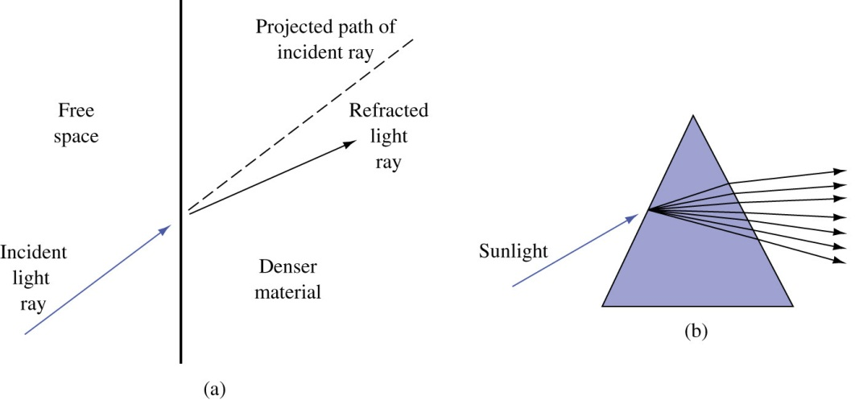
Introduction
Before one can understand the propagation of light in a glass fiber, it is necessary to review some basics of light refraction and reflection.
The speed of light in free space is 3 X 10⁸ m/s but is reduced in other media, including fiber optic cables. The reduction as light passes into denser material results in refraction of the light.
Refraction causes the light wave
to be bent, as shown. The speed
reduction and subsequent refraction
is different for each wavelength.

Slide 15
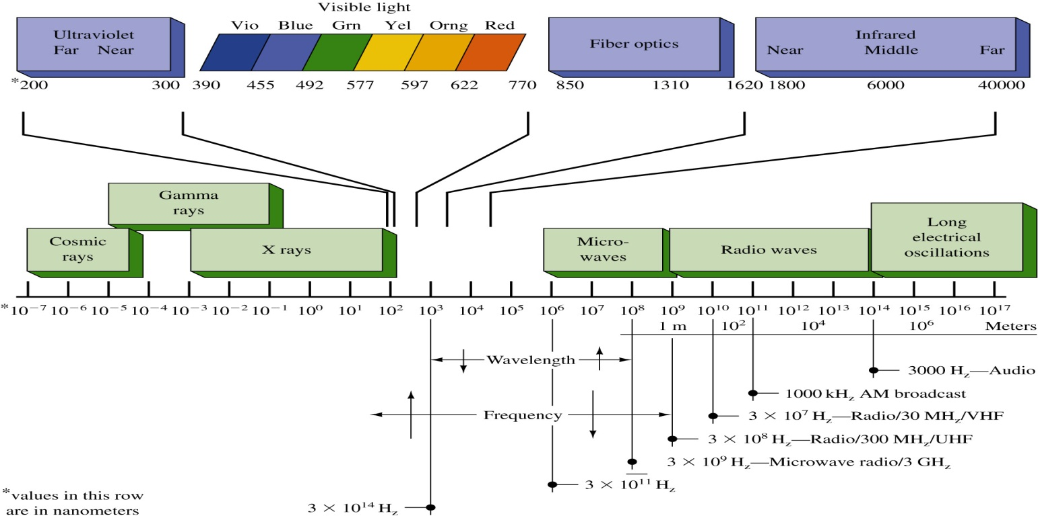
Introduction
The visible light striking the prism causes refraction at both air/glass interfaces and separates the light into its various frequencies (colors) as shown. This same effect produces a rainbow, with water droplets acting as prisms to split the sunlight into the visible spectrum of colors (the various frequencies).

Slide 16
Introduction
The electromagnetic light waves just below the frequencies in the visible spectrum are extending from 680 nm and up and called infrared light waves. Whereas visible light has a wavelength from approximately 430 nm up to 680 nm. Infrared light extends from 680 nm up to the microwaves.

Slide 17
Introduction
The frequency of visible light ranges from about 4.4 x 10¹⁴ Hz for red up to 7 x 10¹⁴ Hz for violet. For the frequencies above visible light, the electromagnetic spectrum includes the ultraviolet (UV) rays and X rays. The frequencies from the infrared on up are termed the optical spectrum.

Slide 18
Fiber-optic systems
The commonly used wavelengths in today's fiber-optic systems are 750 to 850 nm, 1310 nm, and 1530 to 1560 nm.
There is investigative work currently underway in the 1600- to 1625-nm range.
Fixed fiber-optic wavelength specifications are simply stated in terms of fixed wavelengths as 850, 1310,or 1550 nm.

Slide 19
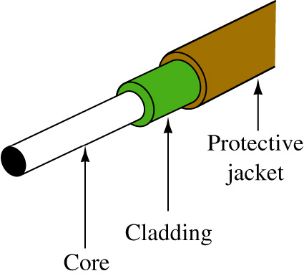
Optical Fiber Construction
Typical construction of an optical fiber is shown. The core is the portion of the fiber strand that carries the transmitted light. Its chemical composition is simply a very pure glass; silicon dioxide, doped with small amounts of germanium, boron, and phosphorous.
The cladding is the material surrounding the core. It is almost always glass, although plastic cladding of a glass fiber is available but rarely used. In any event, the refraction index for the core and the cladding are different. A plastic coating surrounds the cladding to provide protection.

Slide 20
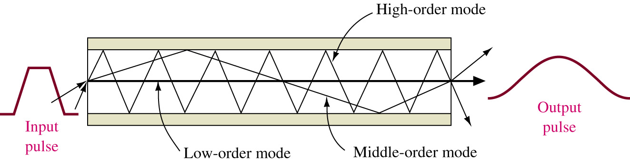
Modes of Propagation
A graphic of a fiber showing three different modes (i.e., multimode) of propagation is presented. The lowest-order mode is seen traveling along the axis of the fiber, and the middle-order mode is reflected twice at the interface. The highest-order mode is reflected many times and makes many trips across the fiber.
As a result of these variable path lengths, the light entering the fiber takes a variable length of time to reach the detector. This results in a pulse-broadening or dispersion characteristic, as shown in Fig. 12-5. This effect is termed pulse dispersion and limits the maximum distance and rate at which data (pulses of light) can be practically transmitted. You will also note that the output pulse has reduced amplitude as well as increased width.

Slide 21
Modes of Propagation
As a result of these variable path lengths, the light entering the fiber takes a variable length of time to reach the detector. This results in a pulse-broadening or dispersion characteristic, as shown. This effect is termed pulse dispersion and limits the maximum distance and rate at which data (pulses of light) can be practically transmitted. You will also note that the output pulse has reduced amplitude as well as increased width.

Slide 22
Modes of Propagation
The greater the fiber length, the worse this effect will be. As a result, manufacturers rate their fiber in bandwidth per length, such as 400 MHz/km. This means the fiber can successfully transmit pulses at the rate of 400 MHz for 1 km, 200 MHz for 2 lkm, and so on. In fact, current networking standards limit multimode fiber distances to 2 km. Of course, longer transmission paths are attained by locating regenerators at appropriate locations. Step-index multimode fibers are rarely used in networking due to their very high amounts of pulse dispersion and minimal bandwidth capability.

Slide 23
Graded-index Fiber
In an effort to overcome the pulse dispersion problem, the graded-index fiber was developed. Graded-index multimode fibers with 50-μm-diameter cores and 125-μm cladding are used in many telecommunication systems at up to 300 megabits per second (Mbps) over 50-km ranges without repeaters.
Graded-index fiber with up to a 100-μm core is used in short-distance applications that require easy coupling from the source and high data rates, such as for video and high-speed local area networks. The larger core affords better light coupling than the 50-μm core and does not significantly degrade the bandwidth capabilities.
In the telecommunications industry, there are two commonly used core sizes for graded-index fiber, these being 50 and 62.5 μm. Both have 125-μm cladding. The large core diameter and the high NA (numerical aperture) of these fibers simplify input cabling and allow the use of relatively inexpensive connectors. Fibers are specified by the diameters of their core and cladding. For example, the fibers just described would be called 50/125 fiber and 62/125 fiber.

Slide 24
Step-index Fiber
A technique used to minimize pulse dispersion effects is to make the core extremely small-on the order of a few micrometers. This type accepts only a low-order mode, thereby allowing operation in high-data-rate, long-distance systems.
This fiber is typically used with high-power, highly directional modulated light sources such as a laser. Fibers of this variety are called single-mode, or mono-mode, fibers. Core diameters of only 7 to 10 μm are typical.
This type of fiber is termed a step-index fiber. Step index refers to the abrupt change in refractive index from core to clad.

Slide 25
Single-mode Fiber
The single-mode fiber, by definition, carries light in a single waveguide mode. A single-mode fiber will transmit a single mode for all wavelengths longer than the cut- off wavelength. A typical cutoff wavelength is 1260 nm. At wavelengths shorter than the cutoff, the fiber supports two or more modes and becomes multimode in operation.
Single-mode fibers are widely used in long-haul and wide area network applications. They permit transmission of about 10 Gbps and a repeater spacing of up to 80 km. These bandwidth and repeater spacing capabilities are constantly being upgraded by new developments.

Slide 26
Chapter 3-2 Key Terms
Refractive Index
Infrared Light
Optical Spectrum
Cladding
Numerical Aperture
Multimode Fiber
Pulse Dispersion

Slide 27
Chapter 12-2 Key Terms
Graded-index Fiber
Single Mode Fiber
Step-index Fiber
Long Haul
Mode Field Diameter

Slide 28
Table of Contents
3.1 Introduction
3.2 The Nature of Light
3.3 Fiber Attenuation and Dispersion
3.4 Optical Components
Fiber Connections and Splices
3.5 Optical Networking Architectures
Optical Ethernet
Campus Issues – Building + Backbone
Wide Area Networking
3.6 Safety

Slide 29
Chapter 3-3
Fiber Attenuation and Dispersion

Slide 30
Introduction
There are two key distance-limiting parameters in fiber-optic transmissions: attenuation and dispersion.
Attenuation is the loss of power introduced by the fiber. This loss accumulates as the light is propagated through the fiber strand, The loss is expressed in dB/km (decibels per kilometer) of length.
The loss, or attenuation, of the signal is due to the combination of four factors: scattering, absorption, macrobending, and microbending.

Slide 31
Attenuation factors
Scattering: This is the primary loss factor over the three wavelength ranges used in telecommunication systems. It accounts for 85% of the loss. The scattering is known as Rayleigh scattering and is caused by refractive index fluctuations. Rayleigh scattering decreases as wavelength increases.
Absorption: The second loss factor, a composite of light interaction with the atomic structure of the glass. It involves the conversion of optical power to heat. One portion of the absorption loss is due to the presence of OH hydroxol ions dissolved in the glass during manufacture. These cause the water attenuation or OH peaks shown in the next slide.

Slide 32
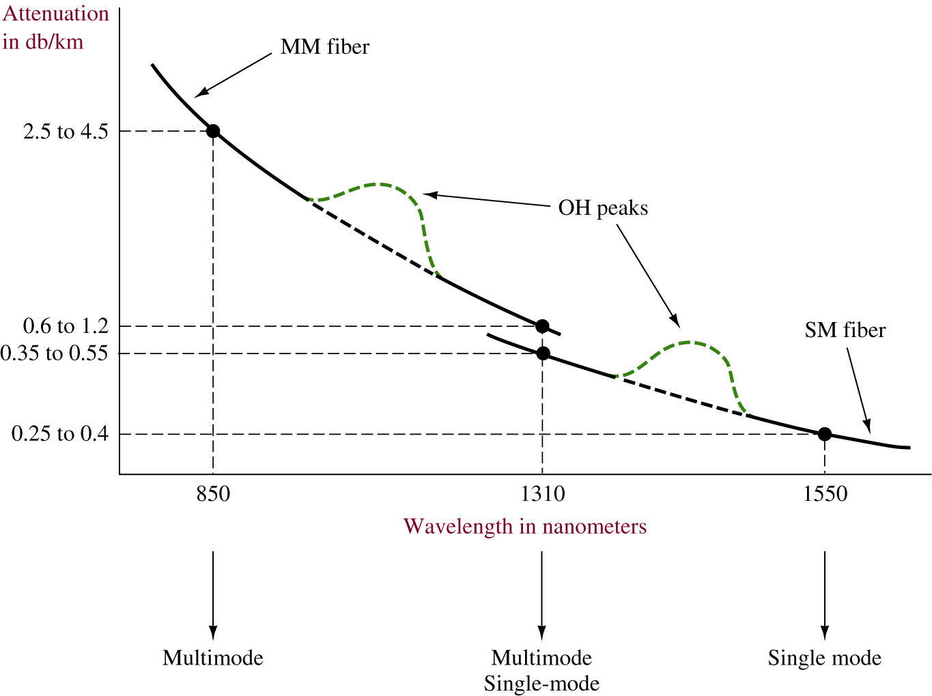
Water attenuation or OH peaks

Slide 33
Attenuation factors
Macrobending: The loss caused by the light mode breaking up and escaping into the cladding when the fiber bend becomes too tight. As the wavelength in- creases, the loss in a bend increases. Although losses are in fractions of dB, the bend radius in small splicing trays and patching enclosures should be minimal.
Microbending: A type of loss caused by mechanical stress placed on the fiber strand, usually in terms of deformation resulting from too much pressure being applied to the cable. For example, excessively tight tie wrap or clamps will contribute to this loss. This loss is noted in fractions of a dB.

Slide 34
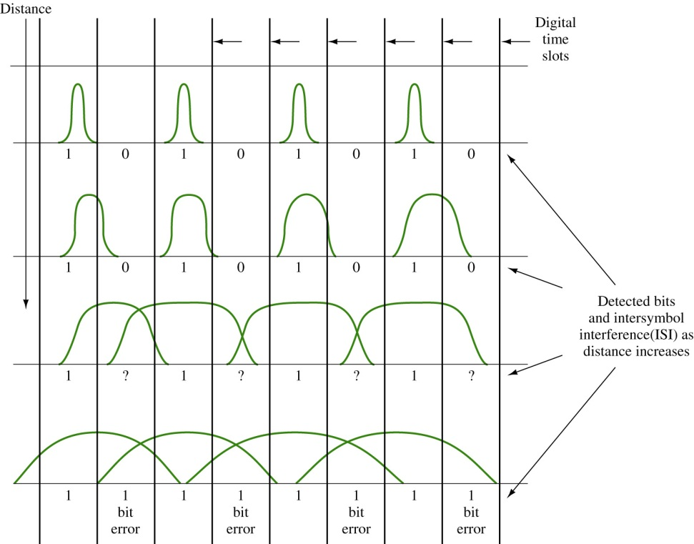
Dispersion
Dispersion, or pulse broadening, is the second of the two key distance-limiting parameters in a fiber-optic transmission system. It is a phenomena in which the light pulse spreads out in time as it propagates along the fiber strand.
This results in a broadening of the pulse. If the pulse broadens excessively, it can blend into the ad-jacent digital time slots and cause bit errors. The effects of dispersion on a light pulse are shown.
There are three types of dispersion: modal, chromatic, and polarization.

Slide 35
Modal Dispersion
Modal dispersion: The broadening of a pulse due to different path lengths taken through the fiber by different modes. Modal dispersion occurs predominantly in multimode fiber. From a light source, the light rays can take many paths as they propagate along the fiber. Some light rays do travel in a straight line, but most take variable-length routes. As a result, the rays arrive at the detector at different times, and the result is pulse broadening.

Slide 36
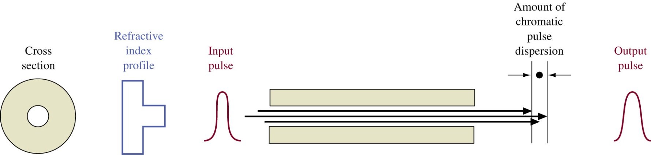
Chromatic Dispersion
Chromatic dispersion: The broadening of a pulse due to different propagation velocities of the spectral components of the light pulse. Chromatic dispersion is present in both single-mode and multimode fibers. Basically, the light source, both lasers and LEDs, produce several different-wavelength light rays when generating the light pulse. Each light ray travels at a different velocity, and as a result, these rays arrive at the receiver detector at different times, causing the broadening of the pulse.

Slide 37
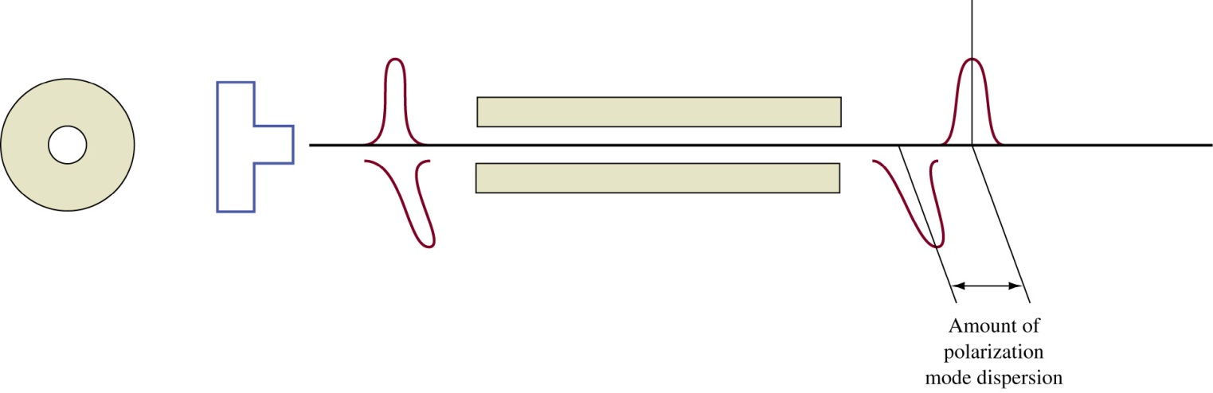
Polarization Mode Dispersion
Polarization mode dispersion: The broadening of a pulse due to the different propagation velocities of the X and Y polarization components of the light pulse. Polarization mode is the type of dispersion found in single-mode systems and becomes of particular concern in long-haul and wide area network high-data-rate digital and high-bandwidth analog video systems. In a single-mode fiber, the single propagating mode has two polarizations, horizontal and vertical, or X axis and Y axis. The index of refraction can be different for the two components and this affects their relative velocity.

Slide 38
Zero-dispersion Wavelength
There is a point where dispersion is actually at zero, this being determined by the refractive index profile. This happens near 1310 nm and is called the zero-dispersion wavelength. By altering the refractive index profile, this zero-dispersion wavelength can be shifted to the 1550-nm region.
Such fibers are called dispersion-shifted. This is significant because the 1550-nm region exhibits a lower attenuation than at 1310 nm. This becomes an operational advantage, particularly to long-haul carriers, since with minimum attenuation and minimum dispersion in the same wavelength region, repeater and regenerator spacing can be maximized.
The next slide shows the water peaks and the need for disperion shifted fibers.

Slide 39
Water attenuation or OH peaks

Slide 40
Dispersion Compensating Fiber
A considerable amount of fiber in use today was installed in the 1980s and early 1990. This cable was called the class IVa variety. These cables were optimized to operate in the 1310-nm region.which means their zero-dispersion point was in the 1310-nm wavelength.
Due to continuous network expansion needs in recent years, it is often desired to add transmission capacity to the older fiber cables by using the 1550-nm region, particularly since the attenuation at 1550 nm is less than at 1310 nm. One major problem arises at this point. The dispersion value is higher at 1550 nm which severely limits its distance capability.

Slide 41
Dispersion Compensating Fiber
In order to overcome this problem, a fiber called dispersion compensating fiber was developed. This fiber acts like an equalizer, negative dispersion canceling positive dispersion. The fiber consists of a small coil normally placed in the equipment rack just prior to the optical receiver input. This does introduce some insertion loss (3 to 10 dB) and may require the addition of an optical-line amplifier.
A new device is a fiber Bragg grating. This technology involves etching irregularities onto a short strand of fiber, which changes the index of refraction and, in turn, reflects slower wavelengths to the output before the faster ones. This results in a compressed, or narrower, light pulse, minimizing inter-symbol interference (ISI).

Slide 42
Chapter 3-3 Key Terms
Scattering
Absorption
Macrobending
Microbending
Dispersion
Modal Dispersion
Chromatic Dispersion
Polarization Mode Dispersion

Slide 43
Chapter 3-3 Key Terms
Zero-dispersion Wavelength
Dispersion Compensating Fiber
Fiber Bragg Grating

Slide 44
Table of Contents
3.1 Introduction
3.2 The Nature of Light
3.3 Fiber Attenuation and Dispersion
3.4 Optical Components
Fiber Connections and Splices
3.5 Optical Networking Architectures
Optical Ethernet
Campus Issues – Building + Backbone
Wide Area Networking
3.6 Safety

Slide 45
Chapter 3-4
Optical Components

Slide 46
Light Sources
Two kinds of light sources are used in fiber-optic communication systems: the diode laser (DL) and the high-radiance light-emitting diode (LED).
The diode laser is a preferred source for medium to high data rates.

Slide 47
DWDM
Most laser emit a fixed wavelength but there is a class of lasers called tunable lasers in which the fundamental wavelength can be shifted a few nanometers
The primary market for these devices is in a network operations environment where DWDM is involved. Traffic routing is often made by wavelength, and, as such, wavelengths or transmitters must be assigned and reassigned to accommodate dynamic routing or networking, bandwidth on demand, seamless restoration (serviceability), optical packet switching, etc.

Slide 48
Splicing
Optical fiber is made of ultrapure glass. Optical fiber makes window glass seem opaque by comparison.
A window made of this pure glass 1 km thick would be as transparent as a normal pane of glass. It is therefore not surprising that the process of making connections from light source to fiber, fiber to fiber, and fiber to detector becomes critical in a system.
The low-loss capability of the glass fiber can be severely compromised if these connections are not accomplished in exacting fashion.

Slide 49
Splicing
Optical fibers are joined either in a permanent fusion splice or with a connector. The connector allows repeated matings and un-matings.
Above all, these connections must lose as little light as possible. Low loss depends on correct alignment of the core of one fiber to another, or to a source or detector. Loss occurs when two fibers are not perfectly aligned within a connector.

Slide 50
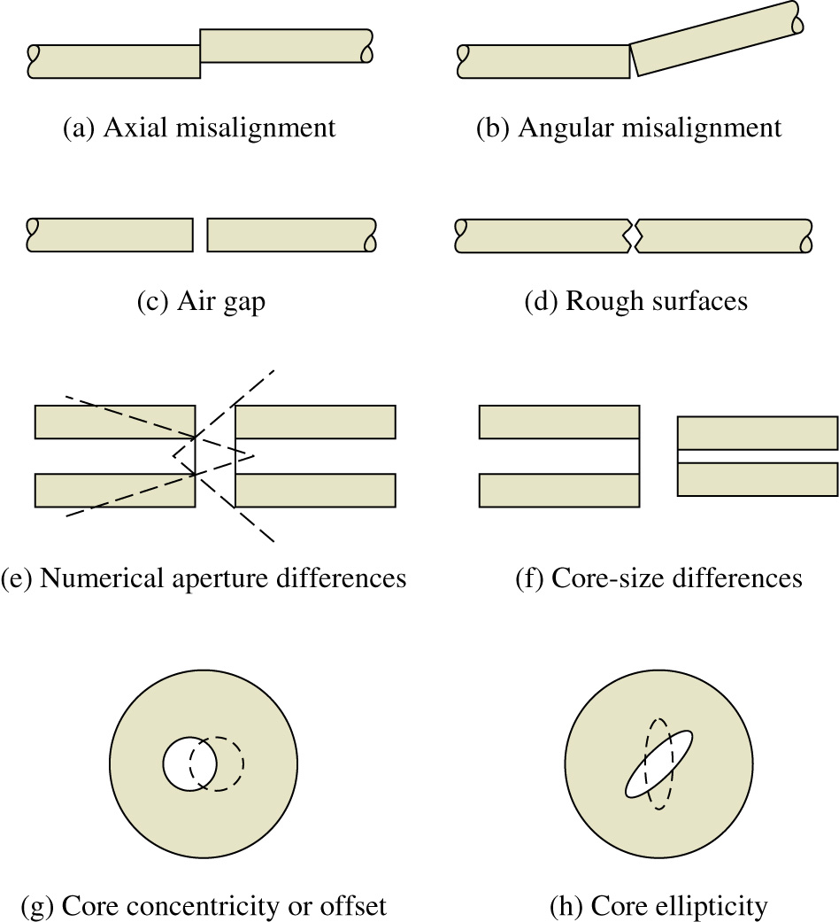

Slide 51
Fusion Splicing
In regard to connectorization and splicing, there are two techniques to consider for splicing. Fusion splicing is a long-term method, in which two fibers are fused or welded together. The two ends are stripped of their coating, cut or cleaved, and inserted into the splicer, The ends of the fiber are aligned and an electric arc is fired across the ends, melting the glass and fusing the two ends together.
There are both manual and automatic fusion splicers; the choice usually depends on the number of splices to be done on a given job, technician skill levels available, and, of course, the budget. Typical insertion losses of less than 0.1 dB-frequently in the 0.05-dB range-can be consistently achieved.

Slide 52
Mechanical Splices
Mechanical splices can be permanent and an economical choice for certain fiber-splicing applications. Mechanical splices also join two fibers together, but they differ from fusion splices in that an air gap exists between the two fibers. This results in a glass-air-glass interface, causing a severe double change in the index of refraction. This change results in an increase in insertion loss and reflected power.
The condition can be minimized by applying an index-matching gel to the joint. The gel is a jellylike substance that has an index of refraction much closer to the glass than air. Therefore, the index change is much less severe.
The best method for splicing depends on the application, including the expected future bandwidth (i.e., gigabit), traffic, the job size, and economics.

Slide 53
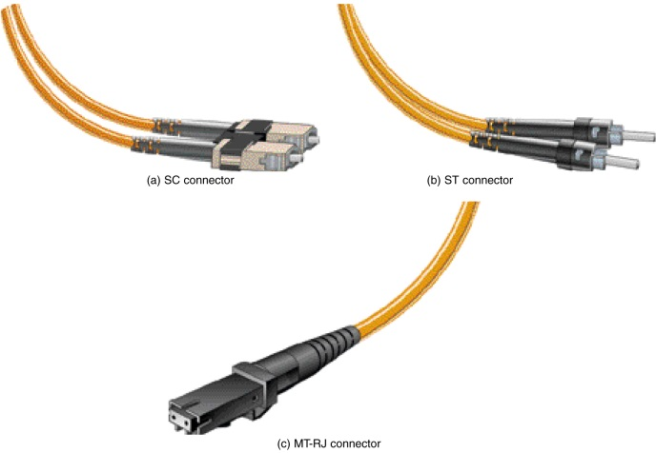
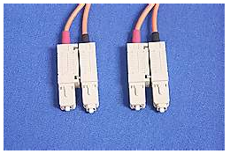
Fiber Connectorization
For fiber connectorization, there are several choices on the market such as SC, ST, FC.LC, MT-RJ and others. The choice of the connector is typicaslly dictated by the hardware being used and the fiber application. Examples of SC, ST, MT-RJ, and LC connectors are provided.

Slide 54
Chapter 3-4 Key Terms
DL (diode laser)
LED (light emitting diode)
DFB (distributed feedback laser)
DWDM (dense wave-division multiplexing
VCSELs (vertical cavity surface emitting lasers)
Tunable Laser
Fiber, Light Pipe, Glass
Isolator
RSL (Received Signal Level)

Slide 55
Chapter 3-4 Key Terms
Fusion Splicing
Mechanical Splices
Index-matching Gel
SC. ST. FC, LC, MT-RJ

Slide 56
Table of Contents
3.1 Introduction
3.2 The Nature of Light
3.3 Fiber Attenuation and Dispersion
3.4 Optical Components
Fiber Connections and Splices
3.5 Optical Networking Architectures
Optical Ethernet
Campus Issues – Building + Backbone
Wide Area Networking
3.6 Safety

Slide 57
Chapter 3-5
Optical Networking

Slide 58
Introduction
The need for increased bandwidth is pushing the fiber-optic community into optical networking solutions that are almost beyond the imagination of even the most advanced networking person.
Optical solutions for long-haul, wide area, metropolitan, campus networks, and local area networks are available. Cable companies are already using the high-bandwidth capability of fiber to distribute cable programming as well as data throughout their service areas.

Slide 59
Introduction
Optical networks are becoming a major part of data delivery in homes, businesses, and for long-haul carriers. The telecommunications industry has been using fiber for carrying long-haul traffic for many years.
Some major carriers are merging with cable companies so that they are poised to provide high-bandwidth capabilities to the home.

Slide 60
SONET Hierarchy Data Rates
Signal Bit Rate Capacity
OC-1 (STS-1) 51,840 Mbps 28DS-Is or 1 DS-3
OC-3 (STS-3) 155.52 Mbps 84DS-Is or 3 DS-3s
OC-12 (STS-12) 622.080 Mbps 336 DS-1s or 12 DS-3s
OC-48 (STS-48) 2.48832 Gbps 1344 DS-1s or 48 DS-3s
OC-192 (STS-192) 9.95328 Gbps 5376 DS-Is or 192 DS-3s
OC: Optical carrier DS-1: 1.544 Mbps
STS: Synchronous transport signal DS-3: 44.736 Mbps

Slide 61
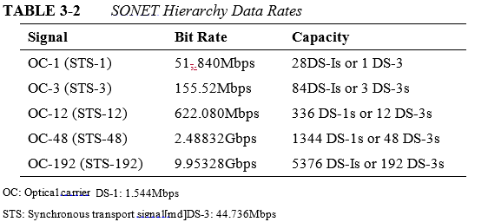
SONET/SDH
When carrying digital signals over SONET, the signal is essentially enveloped or encapsulated within the optical carrier. Table 3-2 lists the more common data rates. The table shows the capacity not equivalence. It merely states that OC-1 is capable of carrying 28 DS-1s or 1 DS-3. With the conversion overhead, it yields a bit rate of 51.84 Mbps when carrying one DS-3 signal.

Slide 62
FTTB
Another architecture in place is fiber to the business (FTTB). A fiber connection to a business provides for the delivery of all current communication technologies including data, voice, video, conferencing, etc.

Slide 63
Optical Ethernet
Conventional high speed Ethernet networks are operating over fiber. This is called optical Ethernet and uses the numerics such as:
10BaseF, 100BaseFX, 1000BaseSX, 10GB
Fiber helps to eliminate the 100-m distance limit associated with unshielded twisted-pair (UTP) copper cable.

Slide 64

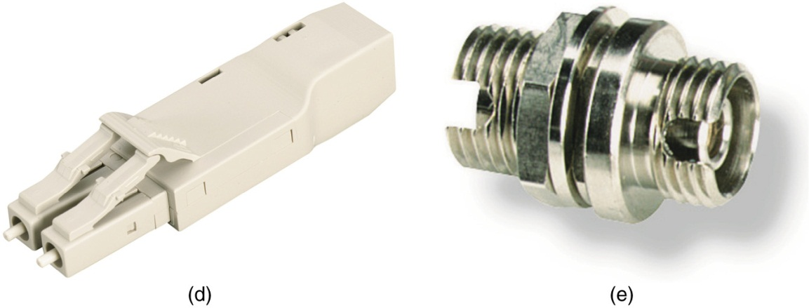

Slide 65
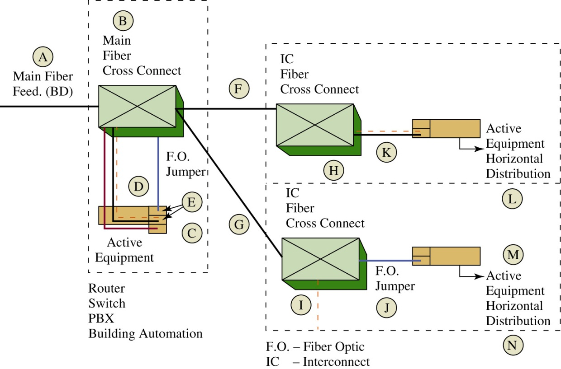
Building Distribution
This figure shows an example of a simple fiber network for a building. Fiber lines consist of a minimum of two fibers, one for transmit and one for receive. Fiber networks work in the full-duplex mode meaning that the links must be able to simultaneously transmit and receive, hence the need for two fibers on each link.

Slide 66
Building Distribution
Item A is the main fiber feed for the building. This is called a building distribution fiber (BD). The two fibers for the BD link terminate into a main fiber cross-connect (Item B). A fiber cross-connect is the optical patch panel used connect the fiber cables to the next link.

Slide 67
Building Distribution
Item A is the main fiber feed for the building. This is called a building distribution fiber (BD). The two fibers for the BD link terminate into a main fiber cross-connect (Item B). A fiber cross-connect is the optical patch panel used connect the fiber cables to the next link.

Slide 68
Building Distribution
Item C represents the active equipment in the main distribution closet in the building. The active equipment could be a router, switch, or a telephone PBX (private branch exchange). Item D shows the jumpers connecting the main fiber cross-connect (item B) to the active equipment (item C).

Slide 69
Building Distribution
The active equipment will need some type of optical interface for the optical-electrical signal conversion, such as a GBIC (pronounced gee-bick) or a XENPAK. GBIC is the gigabit interface converter and the XENPAK is the 10 gigabit converter used for transmitting and receiving higher speed signals over fiber optic lines. The GBIC modules are designed to plug into interfaces such as routers and switches.

Slide 70
Building Distribution
Items F and G show the two fiber pairs patched into the main fiber cross-connect connecting to the intermediate distribution closet (IDC). These fibers (F and G) are called the interconnect (IC) fibers. The fibers terminate into the IDC fiber cross-connects (items H and I).

Slide 71
Building Distribution
Items F and G show the two fiber pairs patched into the main fiber cross-connect connecting to the intermediate distribution closet (IDC). These fibers (F and G) are called the interconnect (IC) fibers. The fibers terminate into the IDC fiber cross-connects (items H and I).

Slide 72
Building Distribution
Items J and K are fiber jumpers that connect the fiber cross-connect to the IDC active equipment. Once again, the active devices must have a GBIC, XENPAK or some other interface for the optical-electrical signal conversion.

Slide 73
The 2-Deep Rule
A general rule for fiber is the distribution in a building should be limited to two deep. This means that a building should only have the main distribution and the intermediate distribution that feeds
the horizontal distribution to the work area.

Slide 74
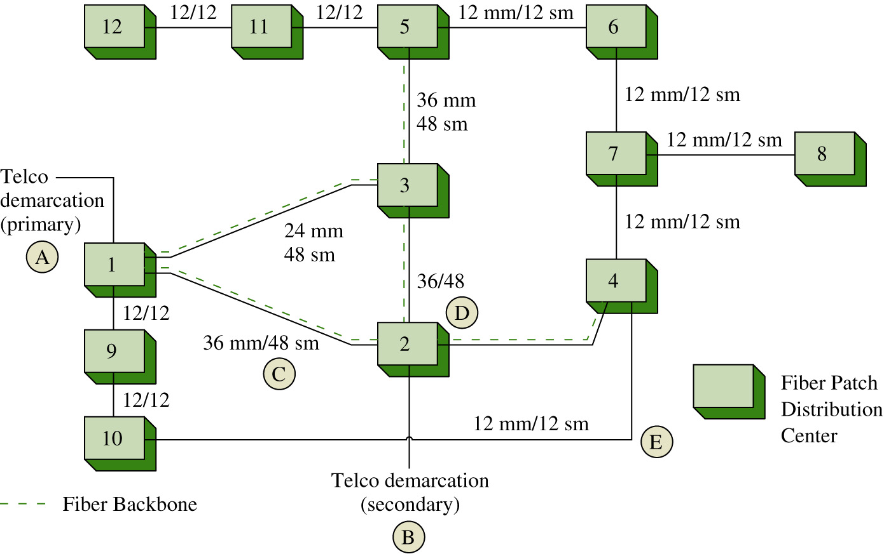
Campus Fiber Distribution
A map of the fiber distribution for a campus network is shown. This map shows how the fiber is interconnected and data is distributed throughout the campus. This is called a logical fiber map.

Slide 75
Optical Ethernet
Another important application of optical Ethernet is extending the reach of the Ethernet network from the local and campus network out to the metropolitan and wide area networks.
Essentially, optical networking is introducing Ethernet as a viable WAN (Wide Area Network) technology. Extending Ethernet into a wide area network is a seamless integration of the technologies.
The Ethernet extension into the WAN simply requires the optical adapters such as a GBIC gigabit interface converter and two fiber strands, one for transmit and one for receive.

Slide 76
Chapter 3-5 Key Terms
Sonet
STS
FTTC
FTTH
FTTB
Optical Ethernet
Fiber Cross-connect
GBIC
IDC
IC

Slide 77
Chapter 3-5 Key Terms
Logical Fiber Map
Physical Fiber Map

Slide 78
Table of Contents
3.1 Introduction
3.2 The Nature of Light
3.3 Fiber Attenuation and Dispersion
3.4 Optical Components
Fiber Connections and Splices
3.5 Optical Networking Architectures
Optical Ethernet
Campus Issues – Building + Backbone
Wide Area Networking
3.6 Safety

Slide 79
Chapter 3-6
Safety

Slide 80
Safety
The eye can’t see fiber optic communication wavelengths, so there is no pain or awareness of exposure. However the retina can still be exposed and damaged.
Use extreme causing when working with fiber. Dangers include:
  Glass
  LEDs

Slide 81
Safety
Do not look into the end of a fiber.
Use safety glasses
Fiber ends are brittle, they can get embedded into the skin

